Slide 1
Biodiversity for the National Parks
Capstone Project
Anthony Zanella

Slide 2
The Data in species_info.csv
Some of the fields in this data set are:
Category of Animal (e.g. Mammal)
Scientific Name (e.g. Cervus elaphus)
Common Names (e.g. American Bison)
Conservation Status (e.g. Endangered)
Some interesting data points I noticed working through the data set:
That over 8% of all species in the original data set excluding those species that needed “no intervention” (15 out of 180) were endangered.
Over 5,000 species needed “no intervention”, dwarfing those species that were in various degrees of trouble.
Over 15% of birds (75 out of 488) are “protected”, the largest such percentage by category.

Slide 3
Significance Calculations for Endangered Status for Various Categories
Some of the significance calculations we did for endangered status between different categories of species are as follows:
Mammals and birds
Based on the chi-squared figure of 0.687594809666, no significant difference between mammals and birds because pval > 0.05
Reptiles and mammals
Based on the chi-squared figure of 0.0383555902297, there is a significant difference between reptiles and mammals because pval_reptile_mammal < 0.05

Slide 4
Recommendation for Conservationists
Based on our significance calculations, reptiles aren’t as big of a concern in regards to endangered species as mammals are. Mammals should continue to receive more attention than reptiles.
Mammals are more likely to be endangered than Birds, but it isn’t a significant difference and both categories should continue to receive equal attention.

Slide 5
Sample Size Determination for Foot and Mouth Disease Study
A section describing the sample size determination that you did for the foot and mouth disease study
Our baseline was 15% due to 15% of sheep at Bryce National Park having foot and mouth disease.
For the "Minimum Detectable Effect“, we took 100 * a 5% change with confidence, our minimum detectable effect would be equal to 100 * x / 15% of the baseline.
We then calculated the sample size by plugging in the two figures above into the sample size calculator and assumed a level of significance of 90%.
Given a baseline of 15% occurrence of foot and mouth disease in sheep at Bryce National Park, if the scientists wanted to be sure that a >5% drop in observed cases of foot and mouth disease in the sheep at Yellowstone was significant, they would have to observe at least 510 sheep.

Slide 6
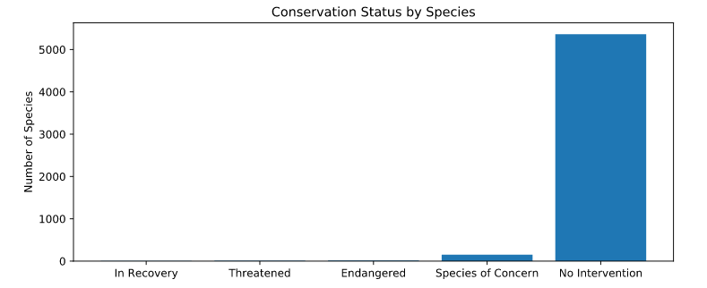
Graphs

Slide 7
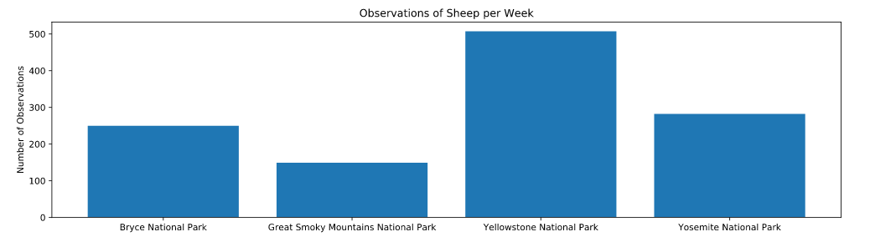
Graphs

